Slide 1

Sage 300 Model Context Protocol Case Study
John Thomas (JT)
Principal Software Architect
September 2025

Slide 2
Welcome
On behalf of Sage and Sage 300, I welcome and thank you for participating in this closed-beta evaluation of an upcoming technology – Model Context Protocol (MCP).
Sage 300 is working on several initiatives with AI technologies and are excited to bring the power, functionality, and features of AI to you. The on-premises customer!
By leveraging an AI front-end, MCP Servers, and the Sage 300 Web API, the approach will deliver measurable, valuable, and requested insights and results for the business stakeholders.
Your feedback will be of immense value as we proceed on delivering this exciting new technology to Sage 300 on-premises customers.
John Thomas
Sage 300 Principal Architect

Slide 3
How MCP adds value
Before we begin, you might be asking "why is this important to me?".
MCP allows AI to access and interact with your specific data, leading to more relevant and customized answers and actions, rather than generic ones.
You can use AI to directly interact with Sage 300 without needing to write complex custom code.
MCP empowers AI models to perform multi-step workflows and enable real-time context and interactions that are responsive to your needs.
MCP is a key step in building a future where AI is not confined to chat interfaces but is a deeply integrated, intelligent assistant that understands and acts upon the context of your digital work.
It is important because you have the questions, Sage 300 has the data, and MCP with the power of AI can answer those questions!

Slide 4
MCP Case Study
Case Study Expectations
What's involved in the evaluation?
Model Context Protocol
What is MCP and what does it provide?
AI Front-end
What is Claude?
MCP Architecture
Understanding the architecture
Running the Evaluation
Sage 300 MCP Configuration

Slide 5

What’s involved in the evaluation?
Simple and straight forward
Download the virtual machine
Configure Claude with your email
Run the Sage 300 MCP Configuration
Determine if you want to access local sample data (Sage 300 2025) or access your live data (Sage 300 Web API access) on your installation of Sage 300
How fun and experiment with meaningful requests
Give us feedback
Note: Feedback on the AI – MCP – Sage 300 concept and not the Claude UI

Slide 6
What is MCP and what does it provide?
MCP Server(s)
Web API
Database
Model Context protocol (MCP) is an open protocol that standardizes how applications provide context to Large Language Models (LLMs). It enables secure integration between LLMs and various data sources and tools.
Sage 300 has created a numerous MCP Servers leveraging a preview version of the ModelContextProtocol package from Microsoft with hosting and dependency injection extensions.
The Sage 300 MCP Servers in turn access the Sage 300 Web API as the data source for fulfilling the request from the front end. The Sage 300 Web API already provides secure, and access-rights based permissions to the requested data.

Slide 7

What is Claude?
Claude is a family of advanced large language models (LLMs) developed by Anthropic.
It functions as a helpful, honest, and harmless AI assistant, available through its web interface, mobile apps, and an API for developers to build other AI applications.
Claude excels at conversation, content creation, text analysis, code generation, and image processing, and is distinguished by its large "context window" for handling lengthy documents and its "Constitutional AI" approach for safe and ethical responses.
Note: Claude is being used in this case study but will be replaced by a Sage AI front end at release time.

Slide 8

Downloading the Virtual Machine
The Virtual Image is available for download:
https://sagena.thruinc.net/Publishing/Link.aspx?LinkID=13JZQOG9Y73GS
Password: Demo?123
Virtual Machine is built with VMWare Pro v17
Download and unzip the VM image
If you do not have VMWare, download and install the VM Ware Player v17.6.3: https://www.techspot.com/downloads/1969-vmware-player.html

Slide 9
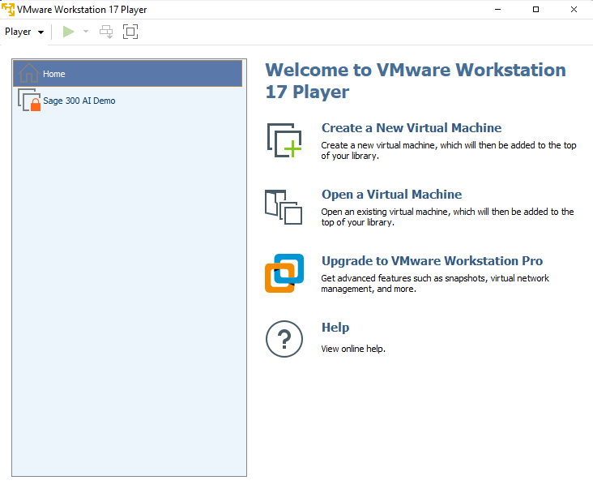
Selecting the Virtual Machine
Run VMWare Player
Select ‘Open a Virtual Machine’
Select the ‘Sage 300 AI Demo.vmx’ file from the downloaded and extracted location
Select and Run the ‘Sage 300 AI Demo’
Password: Demo?123
Note: Edit virtual machine settings as needed (default config is 12GB of memory)
Select ‘Play virtual machine’

Slide 10
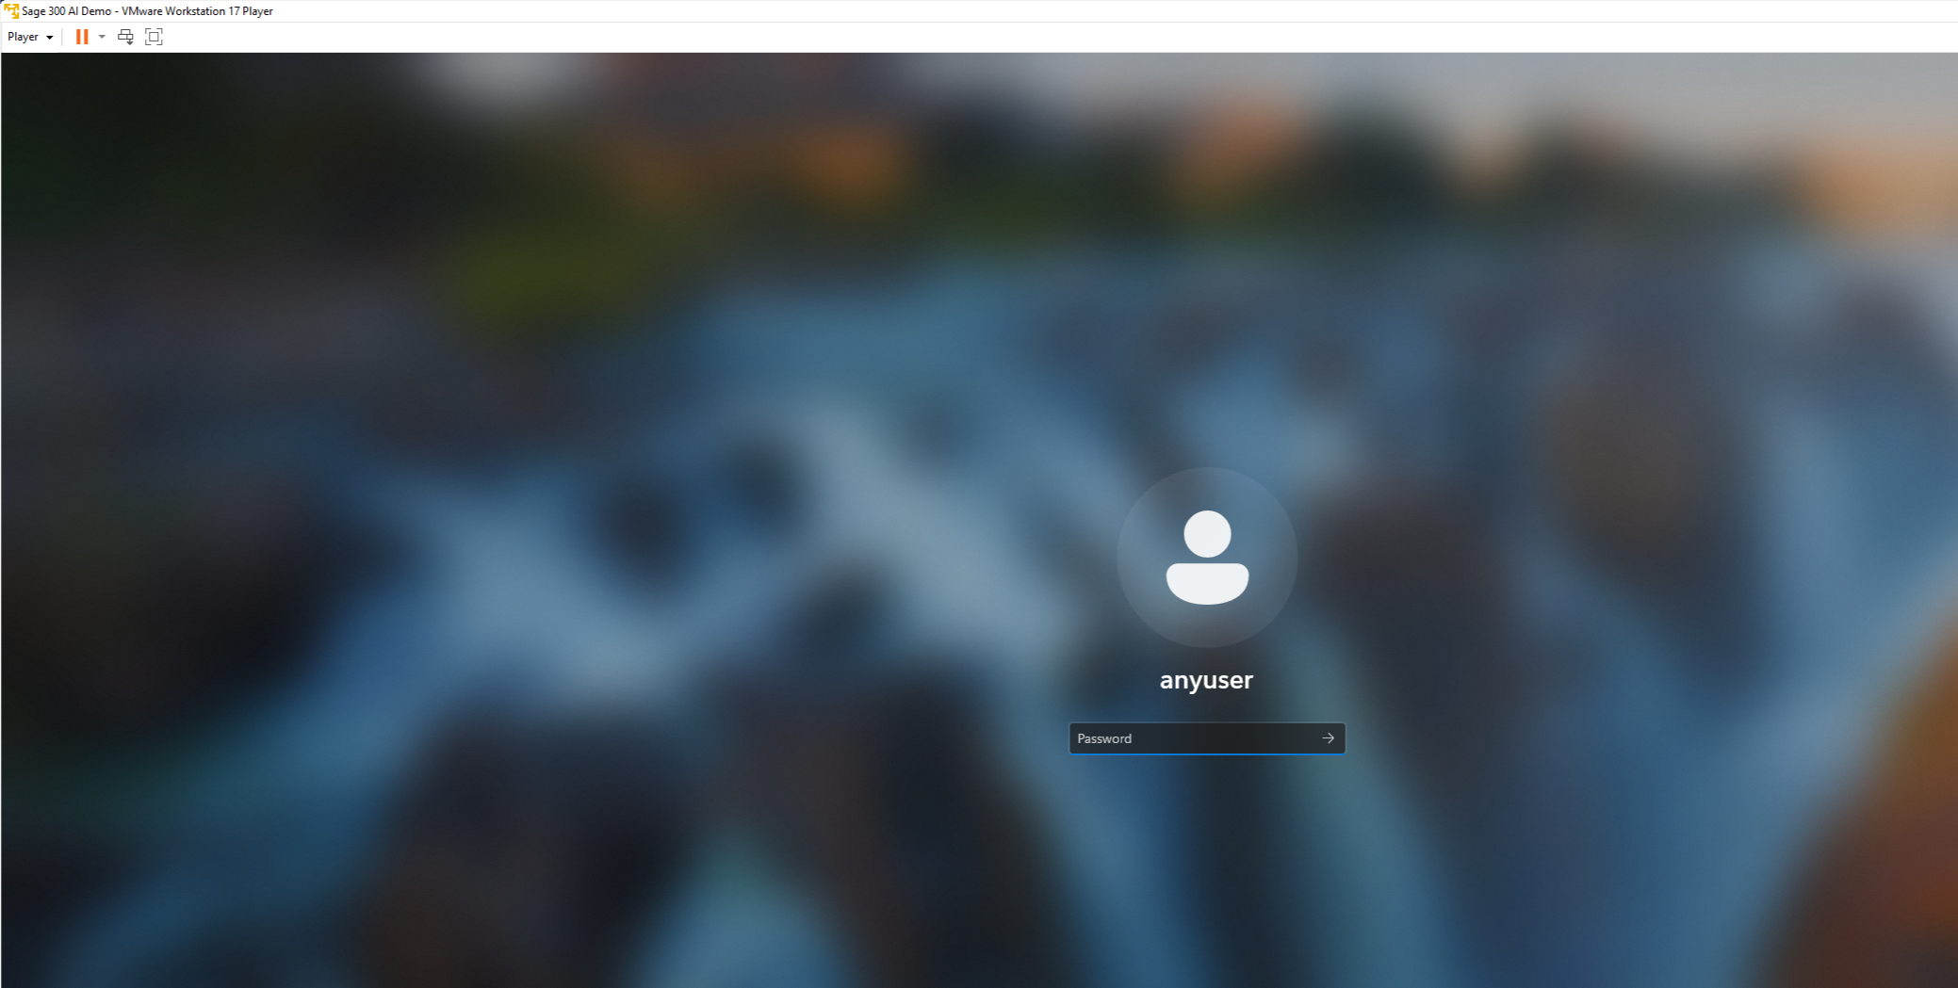
Accessing the Virtual Machine
Virtual Machine Login Credentials
User: anyuser
Password: Demo?123
Machine Configuration
Windows 11 Enterprise Evaluation (90-day license)
Sage 300 2025 (90-day license)
User: ADMIN
Password: Demo?123
SQL Server 2022 (90-day license)
User: sa
Password: Demo?123
MCP Configuration Tool and MCP Servers
Claude AI – Team Subscription (1 per company)
Note: 90-day licenses expire October 31, 2025.

Slide 11
Installing Claude
In the Download folder, run the “Claude-Setup-x64.exe” or download from here: https://claude.ai/download
Click on the “Get started” button after installation.
Enter in your work email when prompted to sign in (only 1 member per company has been assigned to the evaluation) and click on “Continue with email”.
In the email from Anthropic, click on the “Sign in to Claude.ai” button which will open a browser.
Be patient and wait for the “Log in with code” link to be displayed. Click this link and enter this code in the dialog back in the VM waiting for the code. Select the “Verify code” button.
Claude is now installed, and it can be shutdown as it will be started later via Sage 300’s MCP Configuration utility.

Slide 12
About Claude
A Team subscription has been purchased for this evaluation and falls under the Claude’s Commercial License:
‘The customer organization maintains control over their User’s data, and Anthropic only processes that data to provide the service on the customer’s behalf, according to our agreement.’
The Team subscription was chosen (Standard Seats) and it should provide enough messages for the evaluation. Like all Claude subscription models, they work on a 5-hour usage basis.
If a usage limit is reached (per member), it will reset in 5 hours or see the Contact Support slide in this presentation to request a limit increase.

Slide 13
Understanding the architecture
MCP servers by module
Reduces AI hallucinations
Add servers based upon role
No direct database access
AI and servers do not have Sage 300 credentials
Only MCP Web API client passes credentials
Existing Sage 300 Web API with no modifications
Access Rights, Security, Permissions performed by Web API
Note: The first invocation of the Web API if the Web API instance is not “spun up” will delay the initial request.
Claude
AR MCP Server
AP MCP Server
{xx} MCP Server
MCP Web API Client
Sage 300 Web API
Sage 300 Database

Slide 14
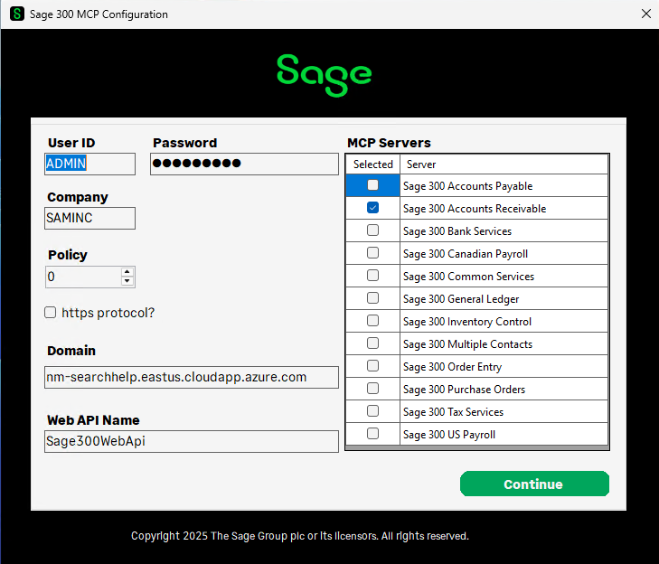
Explaining the MCP Configuration
User ID and Password – Enter the Sage 300 User ID and Password
Company – Enter the Sage 300 Company to be used as default
Policy – Ignore. Future use.
Protocol – Checked for https protocol for Web API otherwise http
Domain – ‘localhost’ for sample data on virtual machine
Specify domain name for remote, live data
Web API Name – Name of Sage 300 Web API instance
Specify name if different than ‘Sage300WebApi’
MCP Servers – Select MCP Servers to be included in Claude AI
Access rights and permissions in Web API
Limit MCP servers based upon role, functionality, and requests
Continue – Save configuration and launch Claude

Slide 15
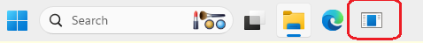
Running the MCP Configuration
The Sage 300 MCP Configuration is the starting point for the evaluation.
It will allow the entry of credentials and destination information for the Sage 300 Web API as well as the selection of which MCP servers to include for the AI front end.
This utility is linked to the start-up task bar of the virtual machine. Click the icon to start the utility.

Slide 16
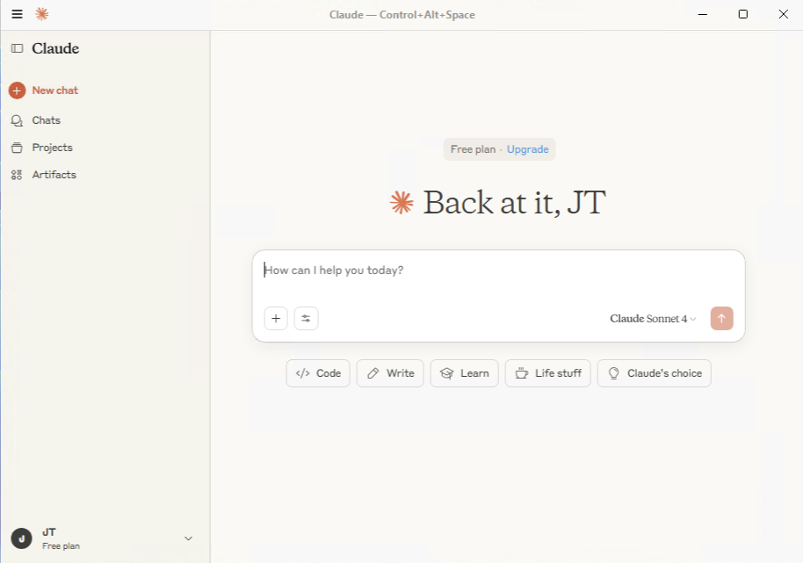
Explaining the Claude UI
We are ready to start!
Claude is ready, but first let’s explain the UI
You will enter your request/query/question in the textbox
To see the MCP servers you have selected, click the hamburger icon in the upper left corner, select File → Settings → Developer to see the list of selected servers from the MCP Configuration utility
Select the ‘New Chat’ link to get back to the main screen

Slide 17
Asking a question
When asking questions, the more specific the question, the better the results
Even a high-level question is possible!
Be sure to have included the MCP servers responsible for answering the requests (i.e., if the AR MCP server is not included in the configuration utility, Claude will not have access to that server and therefore will be unable to provide an answer for an AR request).
If multiple servers are included, certain questions would need to be specific in the request (i.e., AP Segment codes and AR Segment codes are ambiguous and therefore must be specified in the request)
On the next slide, let’s look at some example requests

Slide 18
Sample requests
‘who is my best customer in SAMINC?’ (AR) – gets lots of data for the default company!
‘get top 5 vendors’ (AP) – get all fields for the top 5 vendors for the default company
‘get top 4 Customer, Number, Short Name, Balance due in customer currency for ar customers’ (AR) – gets only 3 fields for the top 4 customers for the default company
‘get top 4 Customer, Number, Short Name, Balance due in customer currency for ar customers from SAMLTD’ (AR) – gets only 3 fields for the top 4 customers for the company ‘SAMLTD’
‘display in a pie chart’ – Displays last requested data in a pie chart. Very cool!
‘display in a line graph’ – Displays last requested data in a line graph. Very cool!
More on the next slide

Slide 19
More sample requests
Let the fun begin!
‘get the 5 customers with the highest balance’ (AR)
‘what is my current cash position in SAMINC?’ (GL)
‘what customers need my immediate attention?’ (AR)
‘what are my bestselling items in SAMINC?’ (IC)
‘can I measure the inventory turnover?’ (IC)
‘what is the inventory turnover for ‘A1-105/0’? (IC)
‘which region generates more revenue?’ (AR)
‘which items are running low and should be ordered?’ (IC)
‘which sales reps are hitting targets?’ (AR)
‘can you help with inventory rationalization?’ (IC)
‘what is my inventory turnover rate?’ (IC)
‘what is my days of inventory on hand?’ (IC)
‘which items do I overstock?’ (IC)
‘what is my order cycle time?’ (PO)
‘is my inventory considered just-in-time?’ (PO/IC)

Slide 20
Troubleshooting and Support
If there are any questions or issues during this evaluation, please contact us
John Thomas (JT) – Sage 300 Architect – John.Thomas@sage.com
Richard Jang – Sage 300 Product Manager – Richard.Jang@sage.com
Some observations with Claude:
Occasionally need to specify the company (i.e., for SAMINC)
Occasionally need to ask it again if it states cannot connect

Slide 21
Feedback
Once again, on behalf of Sage and Sage 300, thank you for participating in this closed-beta evaluation of an upcoming technology – Model Context Protocol (MCP).
Your time is valuable, and we appreciate you taking time out of your busy schedule.
We are excited about this technology and feel it is important to you to leverage the power of AI with MCP technology.
We look forward to your feedback on this upcoming technology and feature. Also remember that the use of Claude as the AI interface will be changed at release time.
A Teams meeting will be scheduled and recorded and made available for upcoming Sage events. Let your voice be heard!

Slide 22
Thank you!

